Slide 1
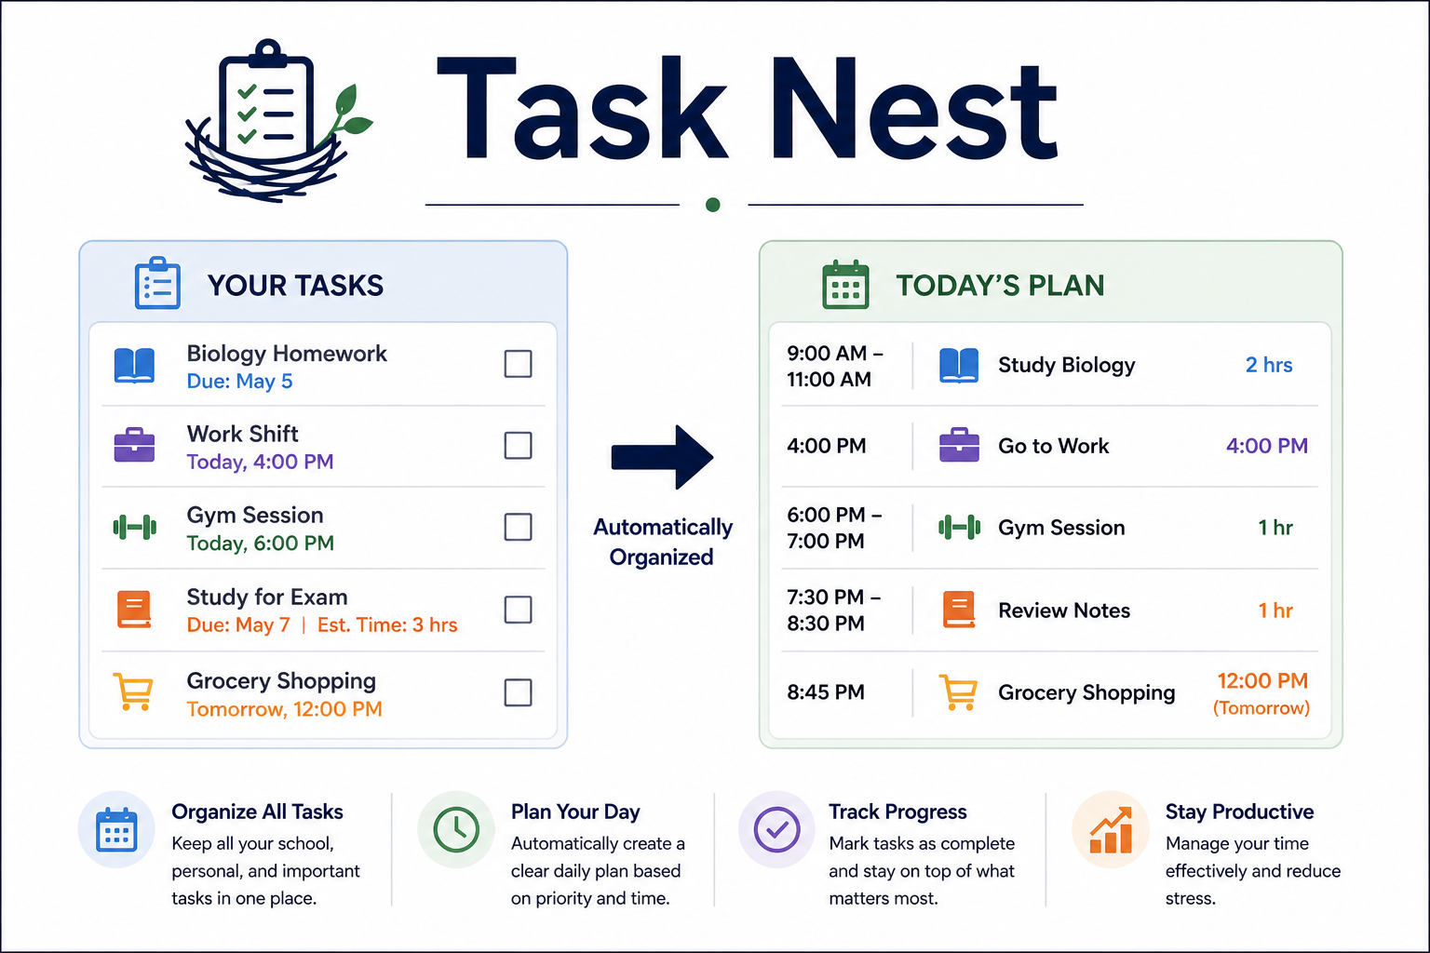
TASK NEST
Gelsi Romero
A structured planner that organizes tasks, prioritizes deadlines, and helps you manage your time effectively.

